Slide 1
REST Api’s for E-commerce
Group 1 :
Aryan Rana
Gaurangi Pradhan
Gauri Kulkarni
Tulika Jain
Lokesh Potala
Shubh Agrawal

Slide 2
Presentation Content
Brief of our Case Study
E-R Diagram
Database Diagram
User Stories
Administrator Stories
Authentication Process

Slide 3
Brief of our Case Study
E-Commerce has become the lifeline of economy today. Ecommerce sites hold 22% of world trade. An ecommerce application should provides users with lot of options not just in terms of products but also, other operations, like payment, delivery. Also preferences related to product purchase can be beneficial to organisations involved in trade to identify different trends related to products.

Slide 4
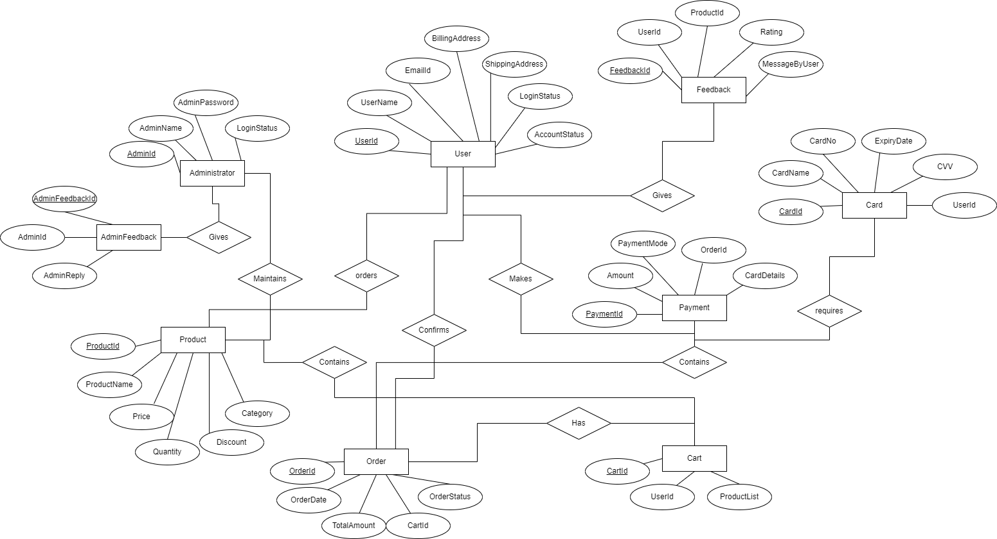
E-R Diagram

Slide 5
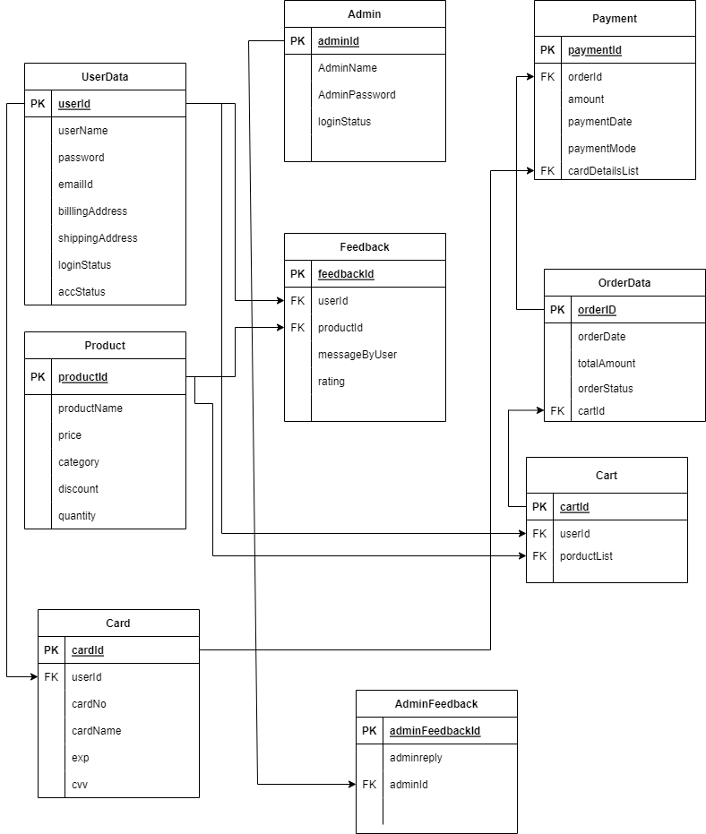
Database Diagram

Slide 6
User Stories :
User should be able to search and view different products details, like product name category wise, price of each product, discounts and offers available over products
User should be able to select a product and place over the cart for
User should have the choice to add or remove products from card
Once confirmed ,user should be able to select the type of payment ,card or cash on delivery
User should be allowed to track the status of ordered product
User should be allowed to rate the product and delivery service 4. Once confirmed, user should be able to select the type of payment ,card or cash on delivery

Slide 7
Administrator Stories
Administrator can view registered users
Administrator can cancel order on request received from User
Administrator can add new products and remove any existing product or update details of product
Administrator can block a user profile
Administrator can respond to feedback and ratings

Slide 8
Authentication Process
A user should be allowed to register and login into the system
User can view products without logging in, but for payment process he/she has to register and have option to provide card details for quick payment service.
User should have the option to select the card details he has provided for checkout, or enter new card details or opt for pay on delivery

Slide 9


